Slide 1
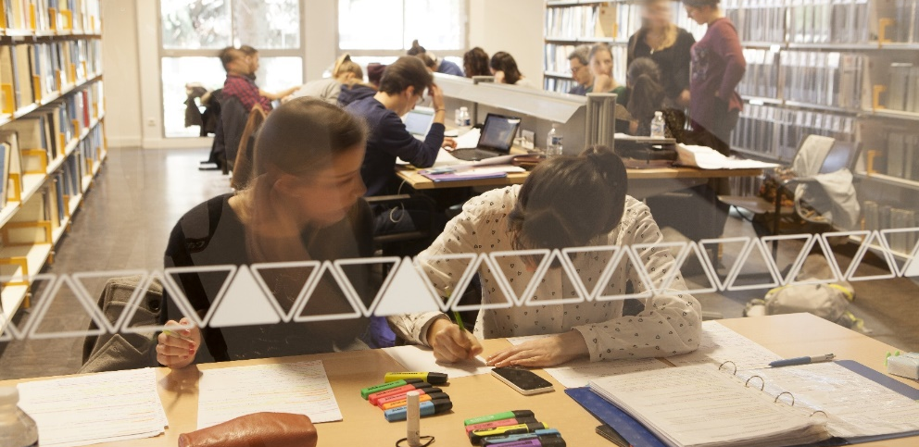
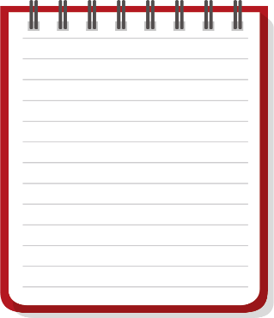
Capitole University
INF RMATION skills
Students
3rd year programme, Semester 5
By following this tutorial, you’ll learn how to carry out effective research and discover more tools to improve your documentary skills.
This compulsory course includes a face-to-face introductory session at the beginning of the academic year and interactive activities to be done online on TSM Academy. Throughout the semester, you can ask for personalised help from your teachers.
MODULE | ACTIVITY | RATING | TRAINING METHOD
Module 1 | Course discovery activity |  | Face-to-face tutorial
Module 2 | What you need to know before you start: the survival kit |  | Online activities
Module 3 | How to choose the right database depending on the subject
Module 4 | Consult the essentials of your discipline: indicative bibliography
Module 5 | Test yourself: do you plan your work? | 1 pt
Module 6 | How to set up an active monitoring system + application test | 2,5 pts
 | Online evaluation | 6,5 pts
Calendar
Pedagogical support
Annual rating
How do I check the work to be done each week? At the beginning of the week, your teacher posts a message on the course forum on TSM Academy.
Mark out of 10 in semester 5
+
Mark out of 10 in semester 6 =
final mark out of 20 1 ECTS at the end of the academic year
Do you have a question you’d like to share with the other students and your teachers? You can post a message on the forum in the online workspace.
Would you like to contact a teacher? You can send them an email here:
christel.candalot@ut-capitole.fr
stephanie.blandin@ut-capitole.fr
You don’t have a computer.
How can you do the online activities?
You can use the public computers in the Arsenal and Manufacture University libraries
You can borrow a laptop at the Manufacture University library
You can borrow a pad at the Arsenal University library
Documentary and pedagogical support Department – Capitole University libraries

